Slide 1
Class 3.10 – Exceptions!
Class 3.10 – 1/17/19
Instructor: Hank dedona

Slide 2
Class 3.9 Recap
Model validation
@NotNull
@Size
@Valid
Enums

Slide 3
Exceptions!
An exception is an event that occurs during the execution of a program that disrupts the normal flow of instructions.
Usually these are considered errors, alternative workflows, etc.
Exceptions are thrown at runtime while running your code/application
Exceptions throw an exception object that contains information about the error, including type, program state and more!

Slide 4
Handlers!
Exceptions are thrown and handled by “handlers”
This is code you’ve written that can handle the exception, usually through a try-catch block
Exceptions are thrown until they can be handled (this could mean that they’re not handled at all and thrown to the JRE and cause the program to exit)

Slide 5
3 (2 if you ask me) Types of Exceptions
Checked exceptions - These are exceptional conditions that a well-written application should anticipate and recover from. They are required to be either a) re-thrown or b) in a try/catch block
Runtime exceptions – These are exceptional conditions that are internal to the application, and that the application usually cannot anticipate or recover from.
Errors (which are really just runtime exceptions)

Slide 6
Throwing exceptions
Throwing exceptions is accomplished via the THROW keyword
E.g. throw new Exception(“Something terrible has happened!”);

Slide 7
Chained exceptions
You can “chain” exceptions in Java.
This is accomplished when you include the original exception in your exception creating a chain
try {
} catch (IOException e) {
throw new SampleException("Other IOException", e); // Includes original IOException
}

Slide 8
Throwable, Exception & Runtimeexception
As mentioned in earlier classes, all classes inherit from the Object class, there is no exception (haha) for exception classes.
Throwable is the most top-level class for java errors.
Exception and error inherit from Throwable (Exception actually extends Throwable)
RuntimeException inherits from Exception

Slide 9
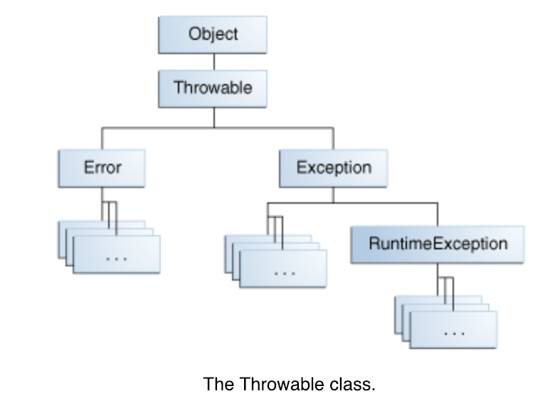
Throwable class hierarchy

Slide 10
Runtime exceptions (aka unchecked)
Runtime exceptions are sometimes used incorrectly since they do not require the use of a try/catch block.
This can lead to poor error handling for the programmer and a poor experience for the user.
Runtime exceptions should only be used for exceptional cases that the programmer cannot recover from

Slide 11
Exceptions vs error-handling code
It’s possible to have your code return some error code or value (like null for instance) instead of throwing an exception
This puts the burden of error handling on every caller of your function/method
It is better to clearly define your methods API and throw exceptions accordingly and spell out how they should be handled to any programmer using your APIS

Slide 12
NEXT…
No studio today (yay!)
Exceptions best practices cheat sheet - https://github.com/LaunchCodeEducation/cheatsheets/blob/master/exceptions-best-practices/README.md
Please start working on your Techjobs (OO edition) assignment - https://education.launchcode.org/skills-back-end-java/assignments/techjobs-oo/

